Slide 1
Arduino Drone
Team 0xDEADBEEF
Ryan Berge and Jeremy DeHaan

Slide 2
Arduino Drone fan
Team 0xDEADBEEF
Ryan Berge and Jeremy DeHaan

Slide 3
Project Goals
fan
Create a Quad-Copter Arduino Remote-Controlled Drone
Wireless Bluetooth Communication for Control Pad
Automatic Take-Off and Landing Procedures
Automatic Stabilization
Music
Low-Light Detection

Slide 4
Original Part List
3-Axis Analog Gyro
4 USAQ 8520 Coreless Brushed Motors
LiPo Battery 350mAh
LiPo Battery Charger
1 XT60 Power Distribution Board
Half-sized Breadboard PCB
2 Qunqi L298N Motor Drive Controllers
2 HC-05 Bluetooth Transmitter/Receiver
Buzzer
Various LED lights
8 Buttons
Ultrasonic Sensor
Photocell Sensor
3D-Printed Chassis
2 Arduino Mega Boards
SPDC Slide Switch
2 USB Cables

Slide 5
Final Part List
3-Axis Analog Gyro
4 USAQ 8520 Coreless Brushed Motors
12 USAQ 8520 Coreless Brushed Motors
LiPo Battery 350mAh
LiPo Battery 850mAh
LiPo Battery Charger
1 XT60 Power Distribution Board
2 XT60 Power Distribution Boards?
Half-sized Breadboard PCB
2 Qunqi L298N Motor Drive Controllers
2 HC-05 Bluetooth Transmitter/Receiver
Buzzer
Various LED lights
8 Buttons
Ultrasonic Sensor
Photocell Sensor
3D Printed Chassis
Several 3D Printed Chassis
2 Arduino Mega Boards
1 Mega, 1 Micro
SPDC Slide Switch
2 USB Cables

Slide 6
Final Part List
3-Axis Analog Gyro
4 USAQ 8520 Coreless Brushed Motors
12 USAQ 8520 Coreless Brushed Motors
LiPo Battery 350mAh
LiPo Battery 850mAh
LiPo Battery Charger
1 XT60 Power Distribution Board
2 XT60 Power Distribution Boards?
Half-sized Breadboard PCB
2 Qunqi L298N Motor Drive Controllers
2 HC-05 Bluetooth Transmitter/Receiver
Buzzer
Various LED lights
8 Buttons
Ultrasonic Sensor
Photocell Sensor
3D Printed Chassis
Several 3D Printed Chassis
2 Arduino Mega Boards
1 Mega, 1 Micro
SPDC Slide Switch
2 USB Cables
Balloons

Slide 7
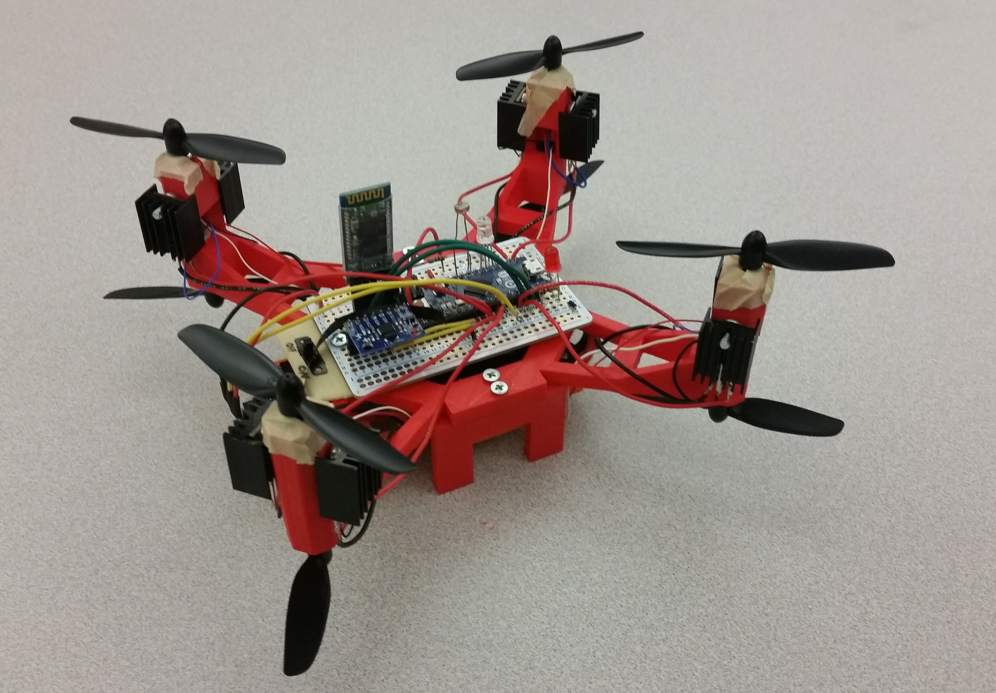
Final Product
Original Goals:
Create a Quad-Copter Arduino Remote-Controlled Drone
Wireless Bluetooth Communication for Control Pad
Automatic Take-Off and Landing Procedures
Automatic Stabilization
Music
Low-Light Detection

Slide 8

Final Product
Original Goals:
Create a Quad-Copter Arduino Remote-Controlled Drone
Wireless Bluetooth Communication for Control Pad
Automatic Take-Off and Landing Procedures
Automatic Stabilization
Music
Low-Light Detection

Slide 9
Final Product
Original Goals:
Create a Quad-Copter Arduino Remote-Controlled Drone
Wireless Bluetooth Communication for Control Pad
Automatic Take-Off and Landing Procedures
Automatic Stabilization
Music
Low-Light Detection

Slide 10
Final Product
Original Goals:
Create a Quad-Copter Arduino Remote-Controlled Drone
Wireless Bluetooth Communication for Control Pad
Automatic Take-Off and Landing Procedures
Automatic Stabilization
Music
Low-Light Detection

Slide 11
Final Product
Original Goals:
Create a Quad-Copter Arduino Remote-Controlled Drone
Wireless Bluetooth Communication for Control Pad
Automatic Take-Off and Landing Procedures
Automatic Stabilization
Music
Low-Light Detection

Slide 12
Final Product
Original Goals:
Create a Quad-Copter Arduino Remote-Controlled Drone
Wireless Bluetooth Communication for Control Pad
Automatic Take-Off and Landing Procedures
Automatic Stabilization
Music
Low-Light Detection

Slide 13
Final Product
Original Goals:
Create a Quad-Copter Arduino Remote-Controlled Drone
Wireless Bluetooth Communication for Control Pad
Automatic Take-Off and Landing Procedures
Automatic Stabilization
Music
Low-Light Detection

Slide 14
Final Product
Original Goals:
Create a Quad-Copter Arduino Remote-Controlled Drone
Wireless Bluetooth Communication for Control Pad
Automatic Take-Off and Landing Procedures
Automatic Stabilization
Music
Low-Light Detection
Drone Actually Flies

Slide 15

Final Product
Original Goals:
Create a Quad-Copter Arduino Remote-Controlled Drone
Wireless Bluetooth Communication for Control Pad
Automatic Take-Off and Landing Procedures
Automatic Stabilization
Music
Low-Light Detection
Drone Actually Flies

Slide 16
Final Product
Original Goals:
Create a Quad-Copter Arduino Remote-Controlled Drone
Wireless Bluetooth Communication for Control Pad
Automatic Take-Off and Landing Procedures
Automatic Stabilization
Music
Low-Light Detection
Drone Actually Flies

Slide 17
Final Product
Original Goals:
Create a Quad-Copter Arduino Remote-Controlled Drone
Wireless Bluetooth Communication for Control Pad
Automatic Take-Off and Landing Procedures
Automatic Stabilization
Music
Low-Light Detection
Drone Actually Flies
fan
fan

Slide 18
Problem?

Slide 19
Problem?
Drone is too heavy.

Slide 20
Problems Along The Way
Bluetooth HC-06 would not enter AT-Command Mode
3D-Printers warped drone parts
3D-Printers overheated and stopped halfway through
3D-Printers were unavailable
Motor Controllers don’t accept enough voltage
Ran out of female-to-female jumper cables
Bellevue store had only two 1.6mm screws
Motor Controllers overheating?

Slide 21
Problems Along The Way (continued)
Motor Controllers are too heavy
Burned out the battery
Drone was too heavy
Drone was too heavy again
Buzzer does some weird things with PWM signals
Buzzer turns off motors?
Propeller flies off the drone
Mosfets melt the chassis

Slide 22
Problems Along The Way (continued again)
Ultrasonic Sonar gives inconsistent data
IMU overflows FIFO buffer
Navigation loop too sensitive
Navigation loop not sensitive enough
Bluetooth sometimes doesn’t connect
Motors have inconsistent speeds
Motors pull more current than they’re supposed to
Built-in Analog-to-Digital circuit does weird things

Slide 23
Still More Problems
Propellers are still flying off
Accidentally destroyed the V-in pin
Accidentally sending power in the wrong direction
Photocell is broken
Diagnostics LED blinds you if you put your face next to it
Drone isn’t stable even when in the air
Micro doesn’t have very many pins
Especially PWM pins

Slide 24
Interesting Problems
Bluetooth
Buzzer
Power

Slide 25
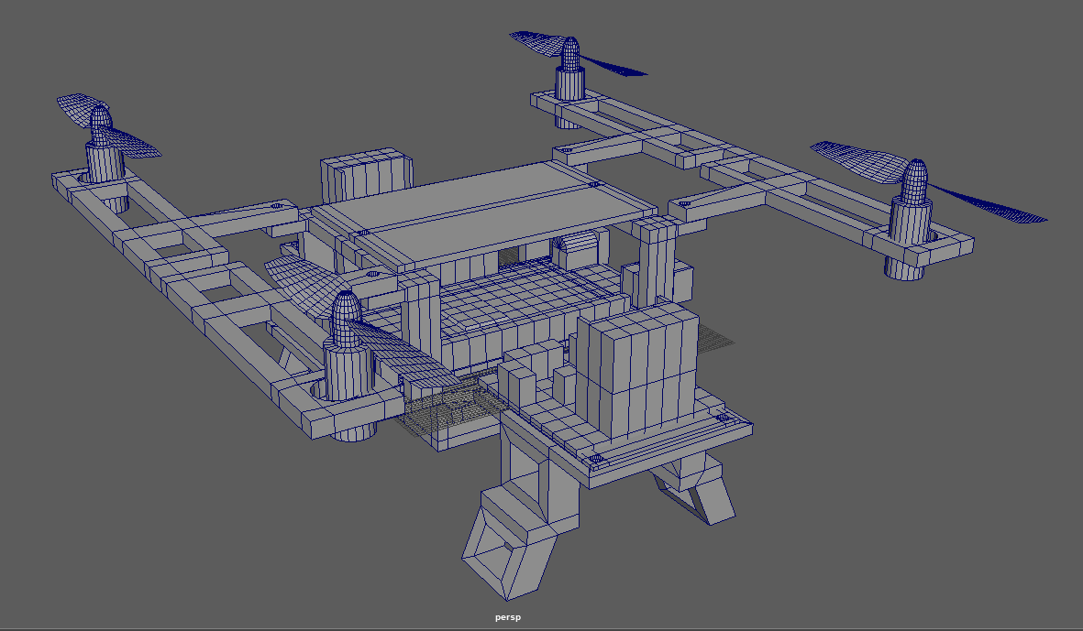
Drone Designs

Slide 26
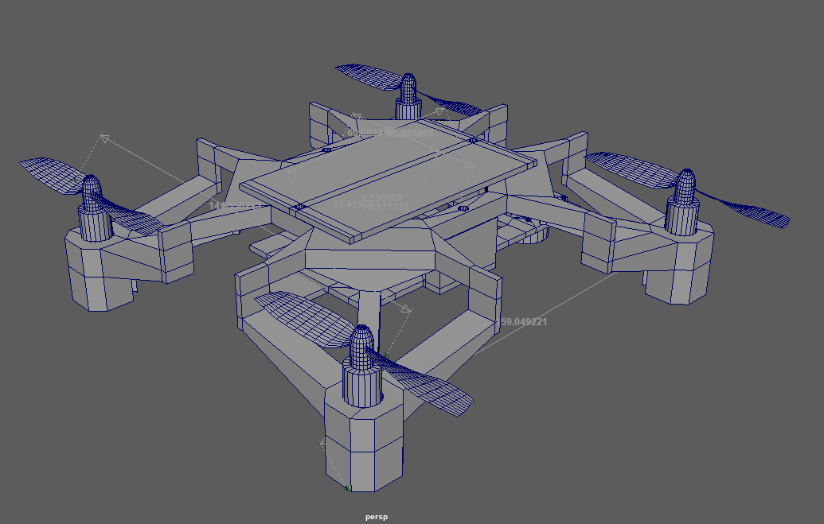
Drone Designs

Slide 27
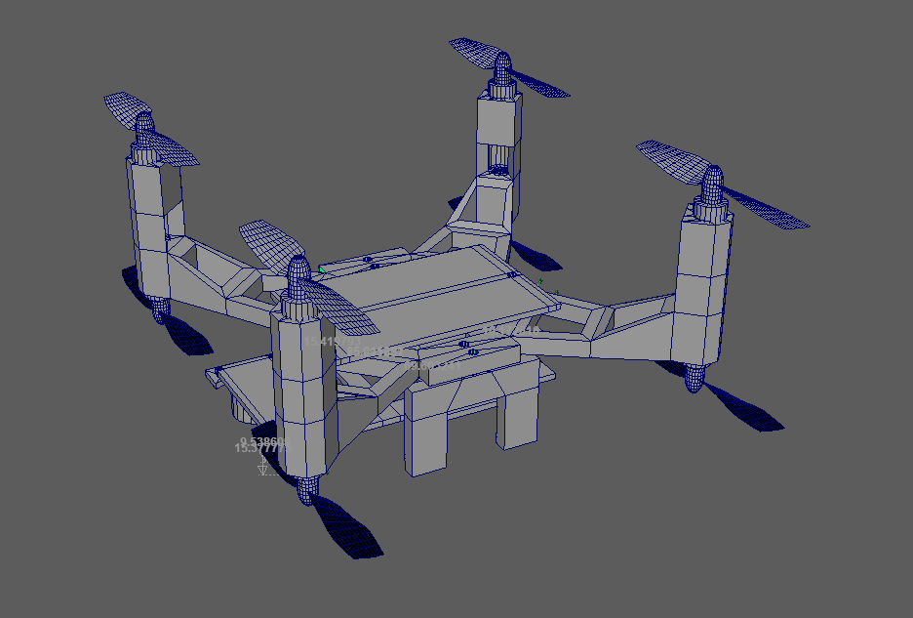
Drone Designs

Slide 28
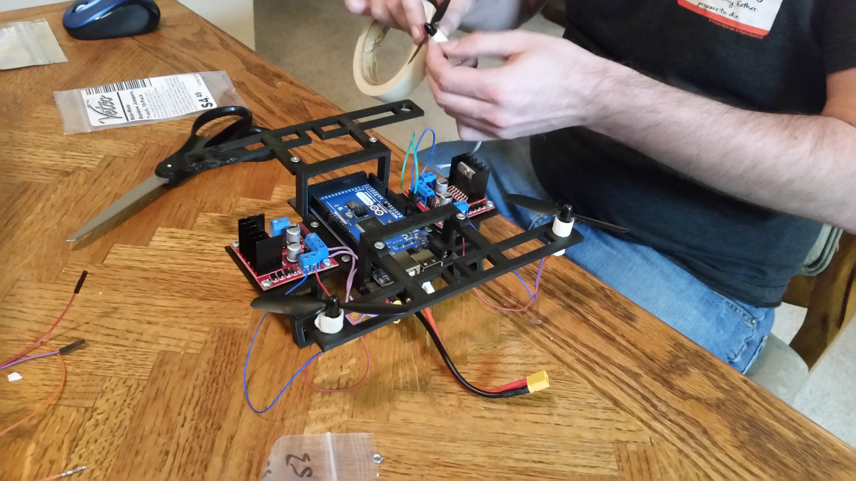
Drone Designs

Slide 29
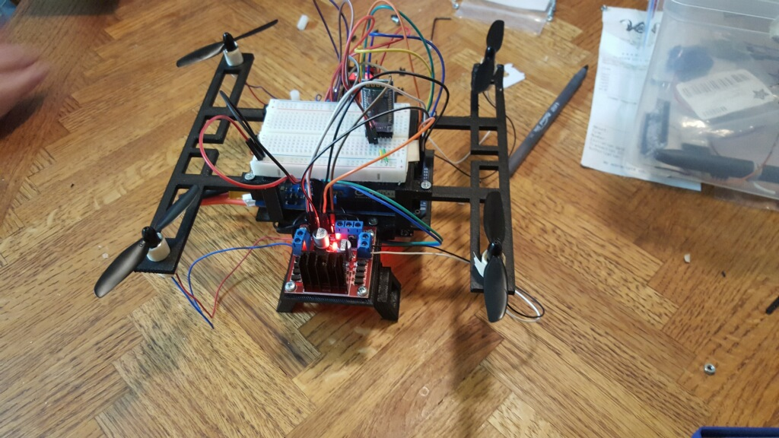
Drone Designs

Slide 30
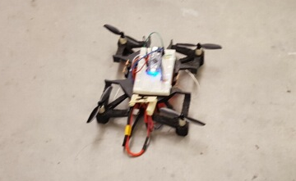
Drone Designs

Slide 31
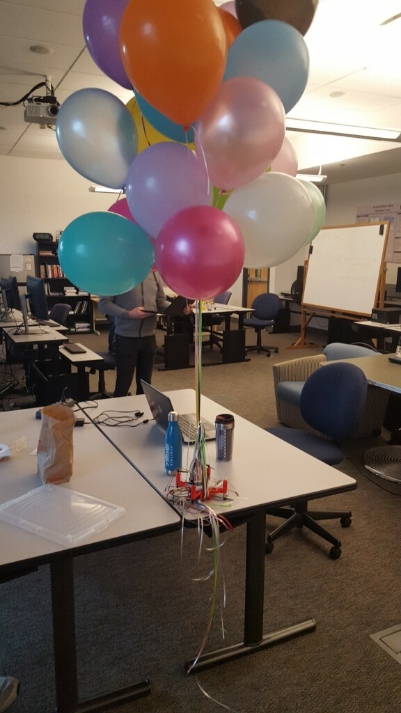
Drone Designs

Slide 32
Drone Designs

Slide 33

System Components
Photocell
Bluetooth
Diagnostic LED
Motors
More Motors
IMU
Power Switch

Slide 34
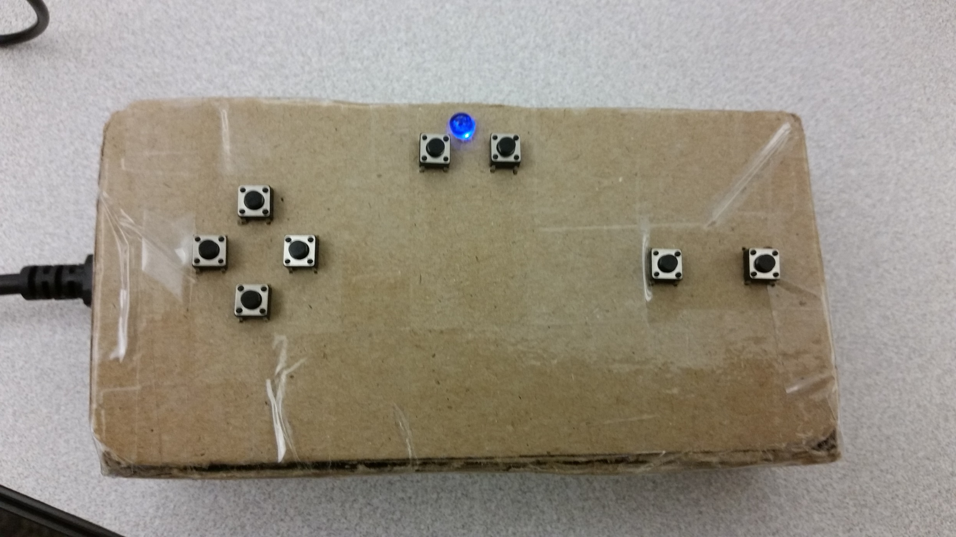
Controller Components
LED
Button
Cardboard
Button
Button
Button
Button
Button
Button
Button

Slide 35
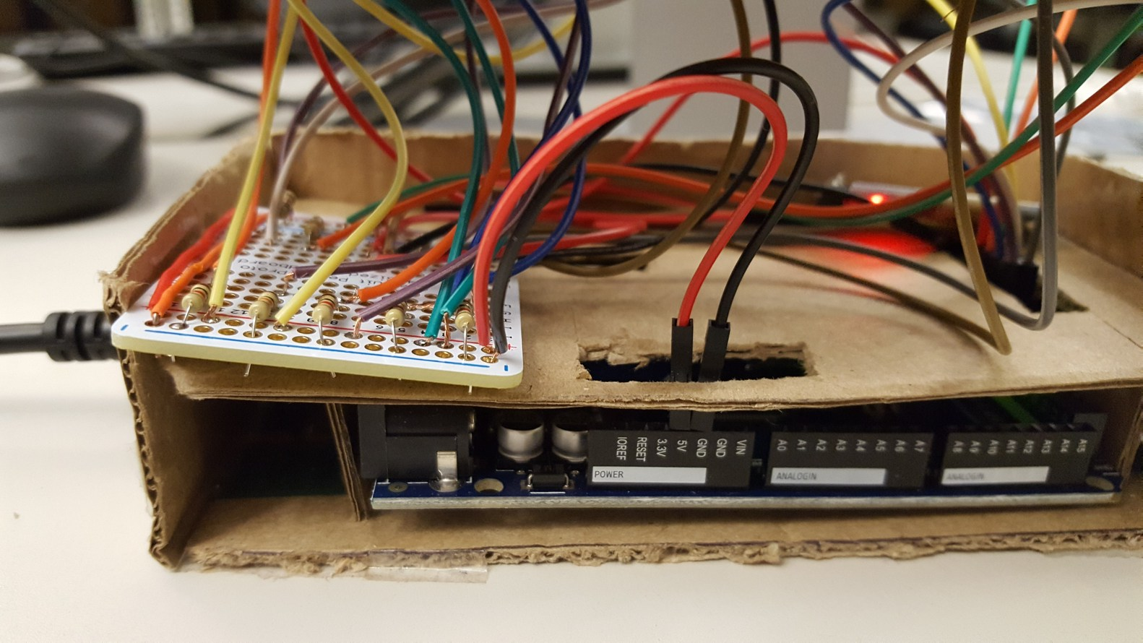
Controller (inside)
Wires
Bluetooth
Arduino Mega

Slide 36
Drone Systems
Communication
2-way Bluetooth between Drone and Controller
Controller receives input from buttons, sends commands to drone
Controller receives data from drone, prints to serial monitor
Navigation
Drone supports multiple states: Landed, Flying, Taking Off, Landing, Testing
Motors are adjusted to achieve some desired state
Commands sent over Bluetooth modify desired state
Diagnostics
Send data back over Bluetooth
Programmable LED provides system-critical information

Slide 37
Sensors
Inertial Measurement Unit (IMU)
Keep track of Pitch and Roll
Ultrasonic Sonar System
Keep track of altitude (for use in take-off and landing procedures)
Photocell
Keep track of ambient light levels
Battery Charge
Detect low-battery (doesn’t really work)

Slide 38
Estimated System Cost
Chassis ---------------------------------------------------------------------------------------------------------- 3D printed: cost unknown
Motors, x8 ----------------------------------------------------------------------------------------------------- $28
Arduino Micro ------------------------------------------------------------------------------------------------- $25
Mosfet Circuit, x8 --------------------------------------------------------------------------------------------- $14
Mosfet Heat Skinks, x8 -------------------------------------------------------------------------------------- $7
IMU -------------------------------------------------------------------------------------------------------------- $8
Battery ---------------------------------------------------------------------------------------------------------- $16
Power Distribution Board ---------------------------------------------------------------------------------- $8
Bluetooth x2 --------------------------------------------------------------------------------------------------- $18
Arduino Mega 2560 ------------------------------------------------------------------------------------------ $50
Voltage Regulator --------------------------------------------------------------------------------------------- $10
Miscellaneous Screws and Wires ------------------------------------------------------------------------- $15
Controller Buttons, x8 --------------------------------------------------------------------------------------- $5
-------------------------------------------------------------------------------------------------------------------------------------------------------------------------------
Total: ~ $200

Slide 39
What We Learned
Hardware selection is vital!
Motors need to be powerful, reliable, and efficient:
Power: Actually generate enough lift
Reliability: Motors need to spin at close to the same speed
Efficiency: The more power required, the bigger the battery must be
Understand Power Requirements
Every system requires power; have a plan for routing power
Be careful with voltage/current rating for individual components
Mosfets get very hot when you run lots of power through them

Slide 40
What We Learned (continued)
Drones are hard

Slide 41
What We Learned (continued)
Drones are hard
fans
easy

Slide 42
What We Learned (continued)
Drones are hard
Next time we’re making a submarine
fans
easy

Slide 43
Demo Time!*
AWAY FROM THE DRONE
Please keep your hands and feet inside the classroom at all times
* Team 0xDEADBEEF will not be held liable for any injuries, psychological or physical, incurred during the proceedings
of this demonstration. Observe at your own risk.

